Slide 1
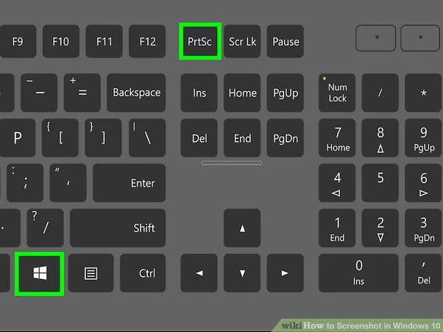
Task A: Project Management Screenshots

Slide 2
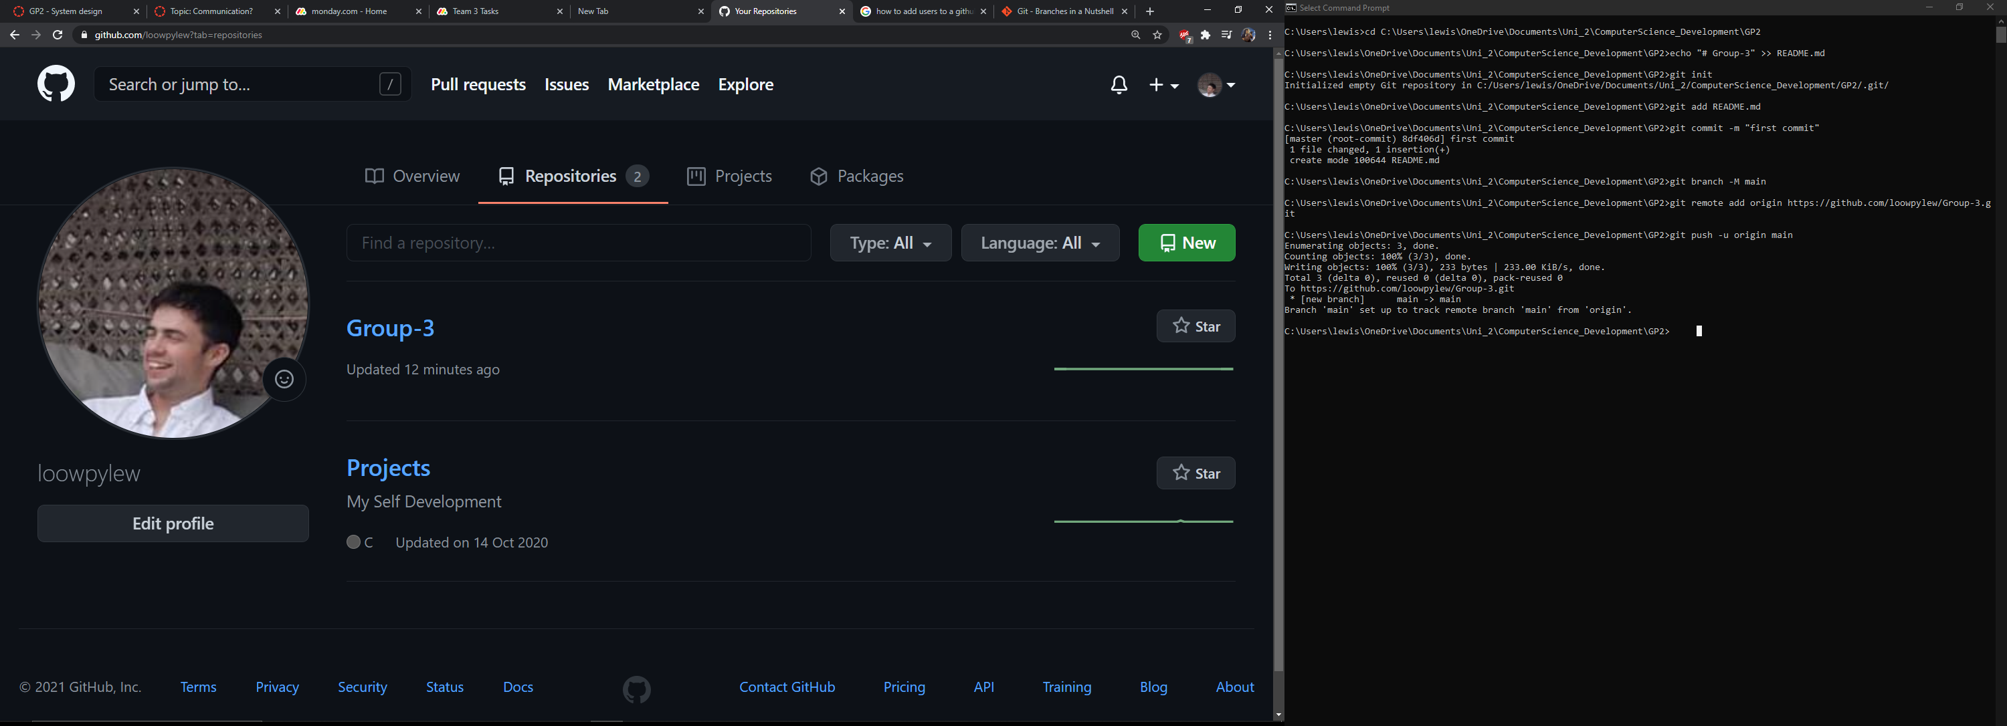
First commit to GitHub Repo, adding a main Branch to echo comment “#Group 3" to mark beginning of first use of GitHub.

Slide 3
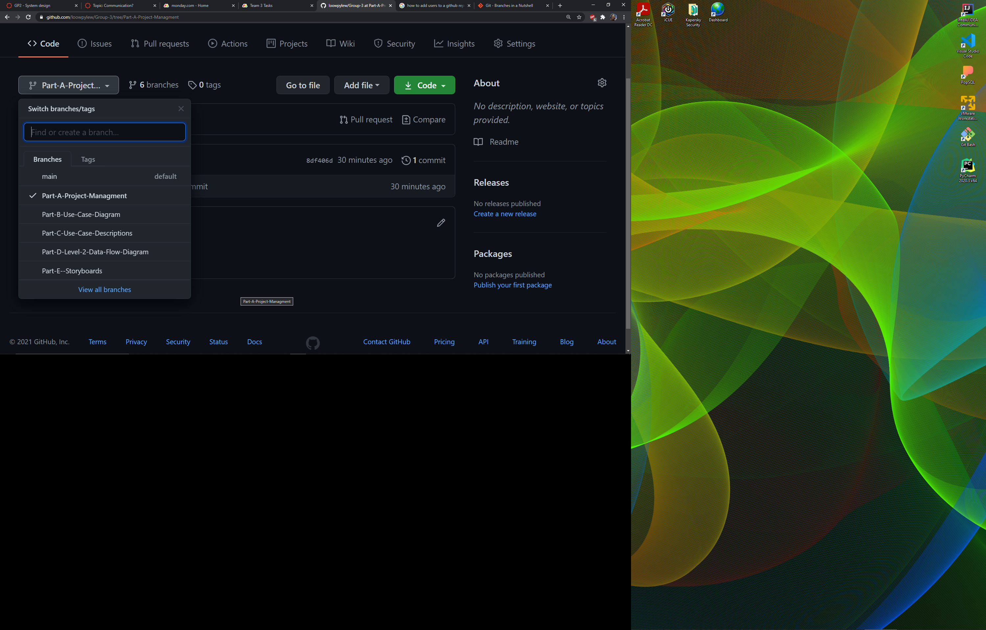
New branches have been created relevant to each part of the assignment for easier management of team members work.

Slide 4
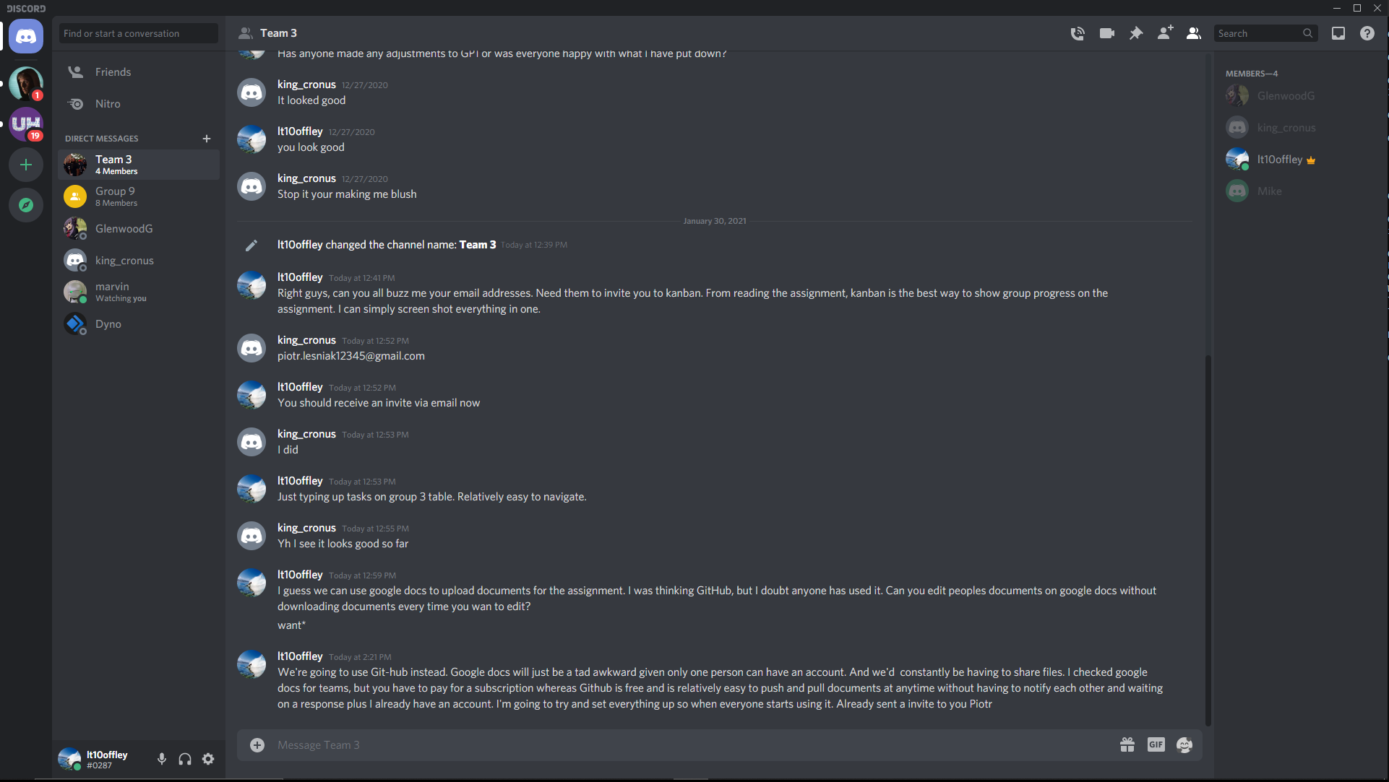
Created a Group Chat with 4 members including Lewis Taylor, Michael Olatunji, Piotr Lesniak, Kellen Pearton and still awaiting confirmation for Jorden Manning. Currently added Piotr to Kanban and has accepted the invite. Waiting on response from the rest of team Date: [30/01/2021]

Slide 5
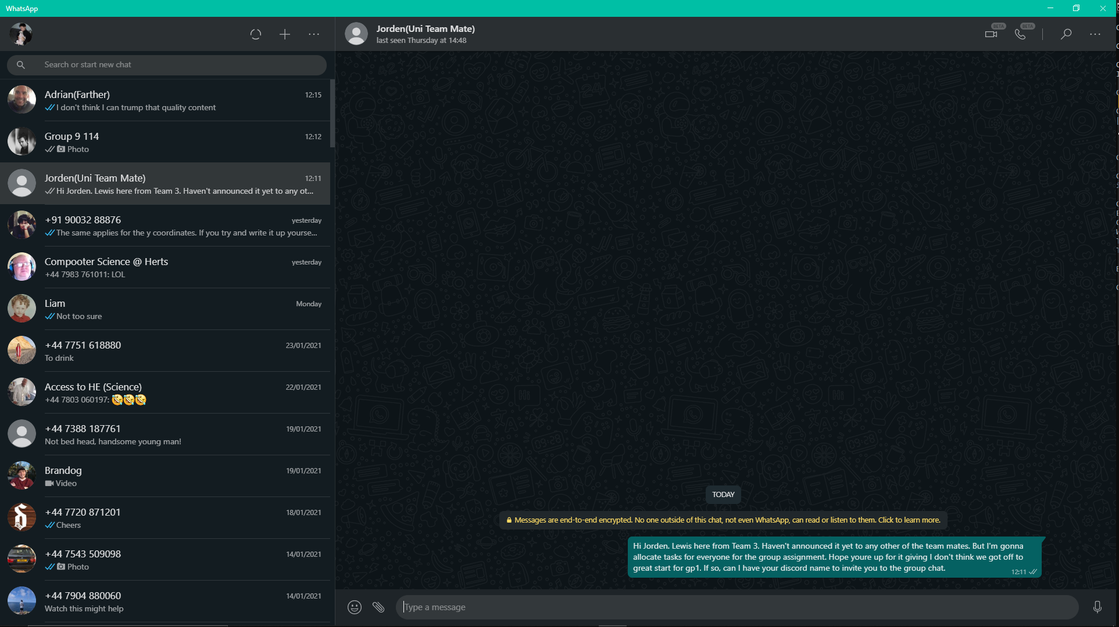
Currently trying to establish contact with Jorden Winning so that he can be added to the group chat. Everyone else has been informed on updates regarding invites to Kanban and GitHub via Discord.

Slide 6
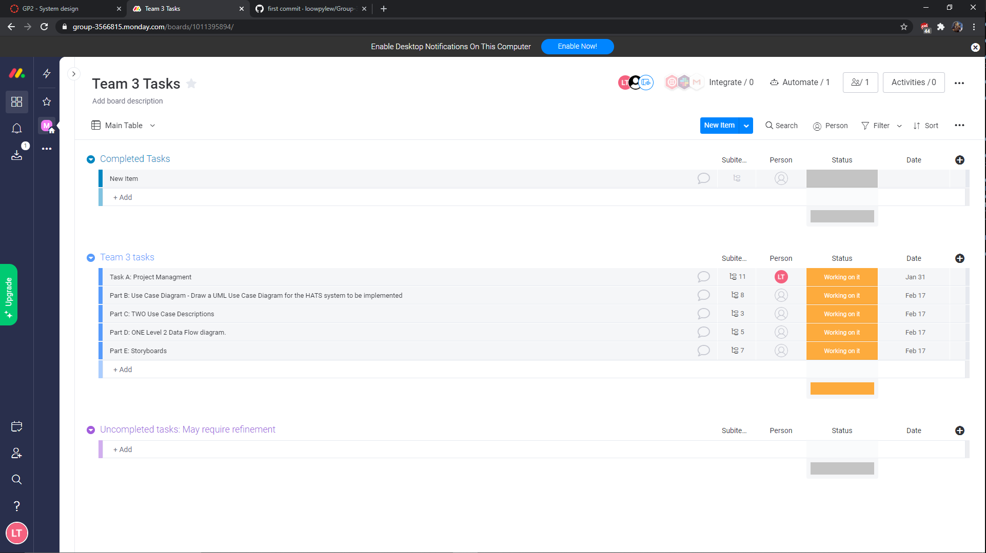
Only task allocated so far is myself, Lewis Taylor. And have allocated myself the task of Project Manager.

Slide 7
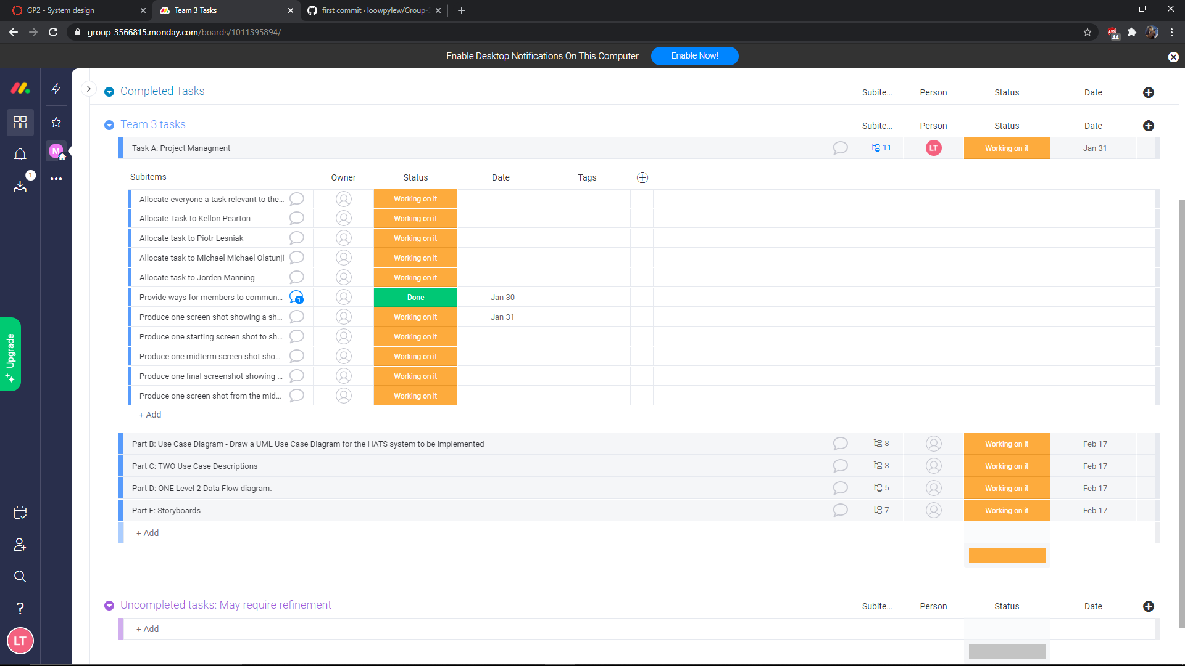
As we can see here, each Task has as series of subtasks which need to be completed in order for the main task status to be registered ;

Slide 8
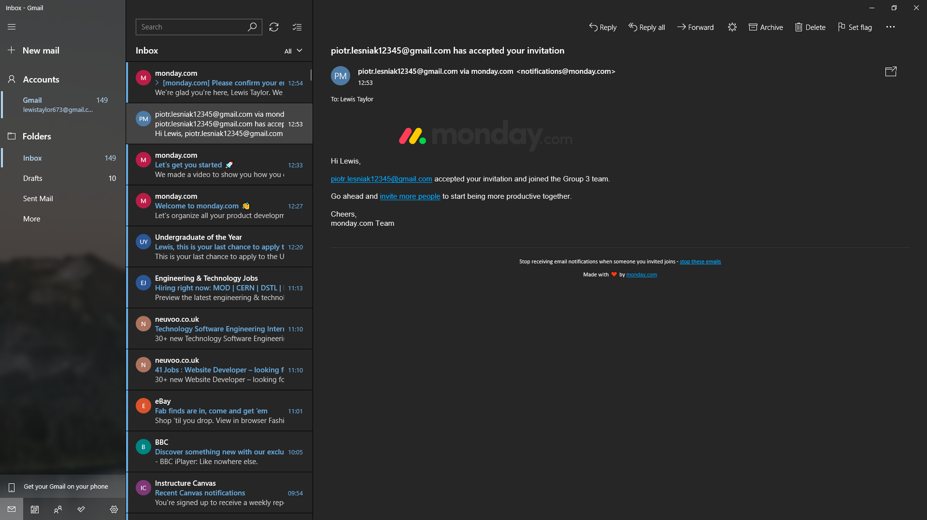
First accepted invite from Piotr to Kanban as a collaborator.

